Slide 1
Project-1 Food Hunt
Srija Reddy Kasam
Srithi Reddy Muthyala

Slide 2
Problem Statement
Now a days people are interested to taste different varieties of food.
But Not aware of :
What kinds of food to try??
Where to get ??

Slide 3
Overview of solution
Design a page to expose different kinds of cuisines to food lovers
List the top rated restaurants in respective cuisines.

Slide 4
Requirements
Front-End : Developed in HTML, CSS.
Web Browsers : Google Chrome, Firefox, Safari, Edge etc.
IDE : Notepad++

Slide 5
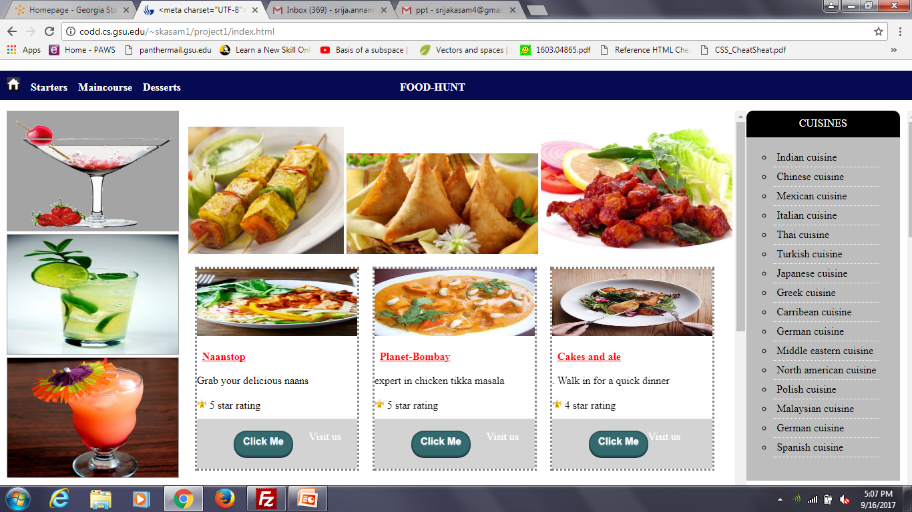
Home Page

Slide 6
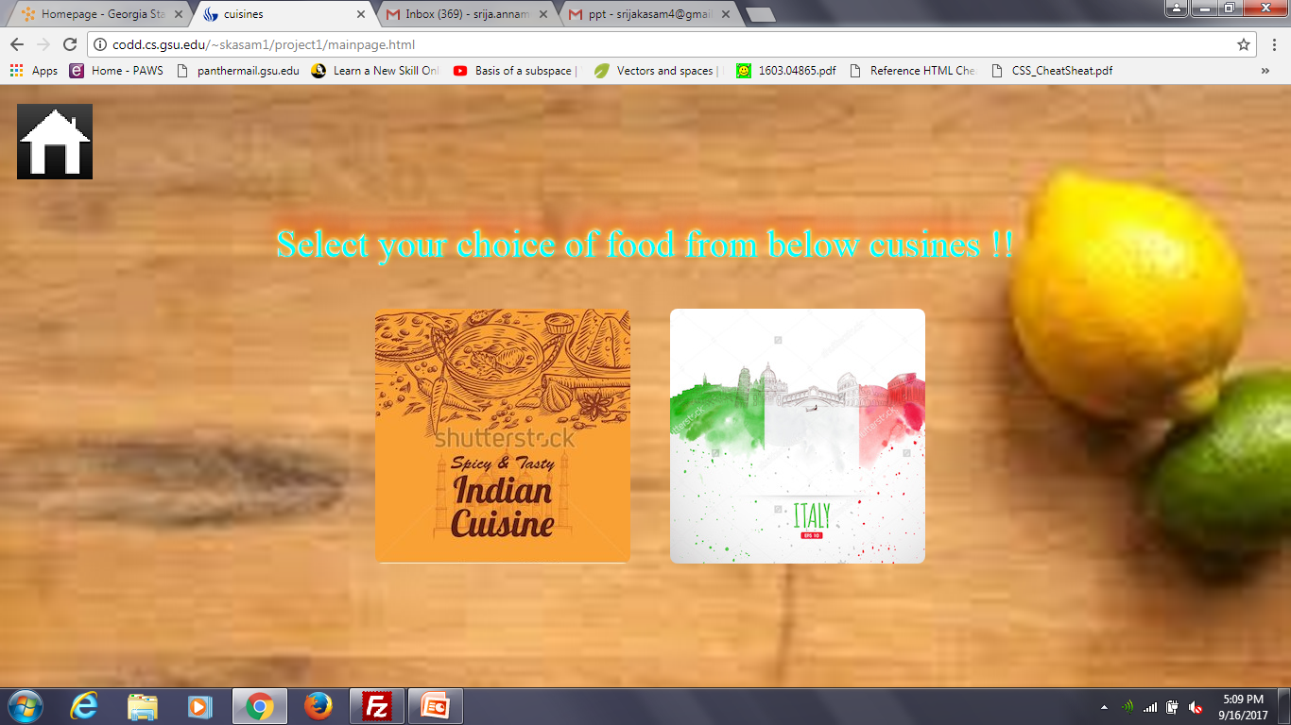
Food Of choice

Slide 7
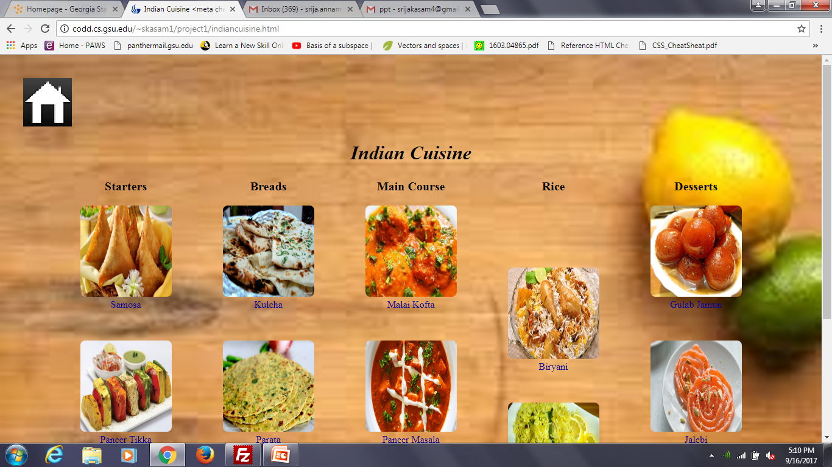
Indian Cuisine

Slide 8
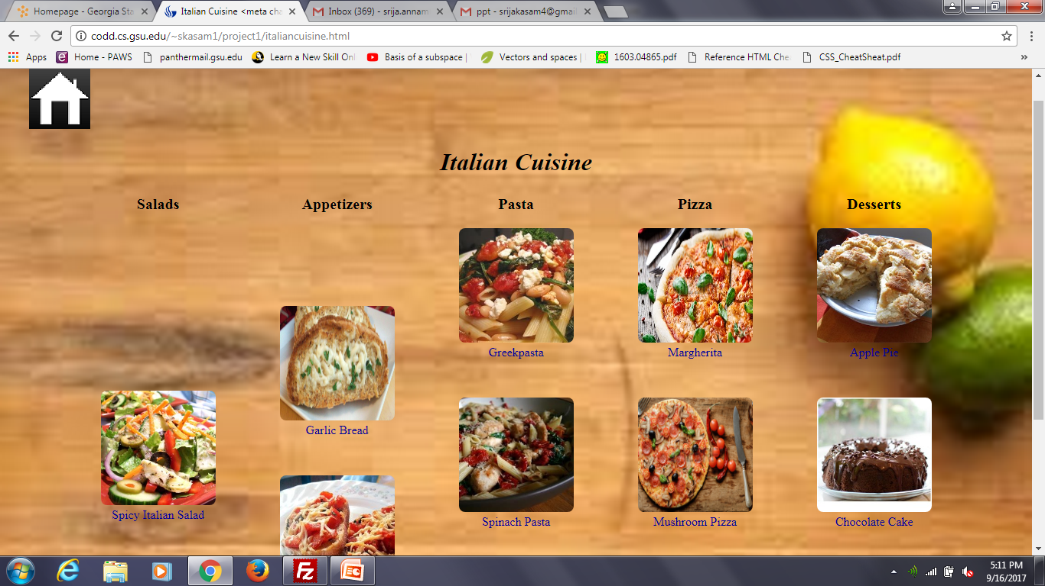
Italian Cuisine

Slide 9
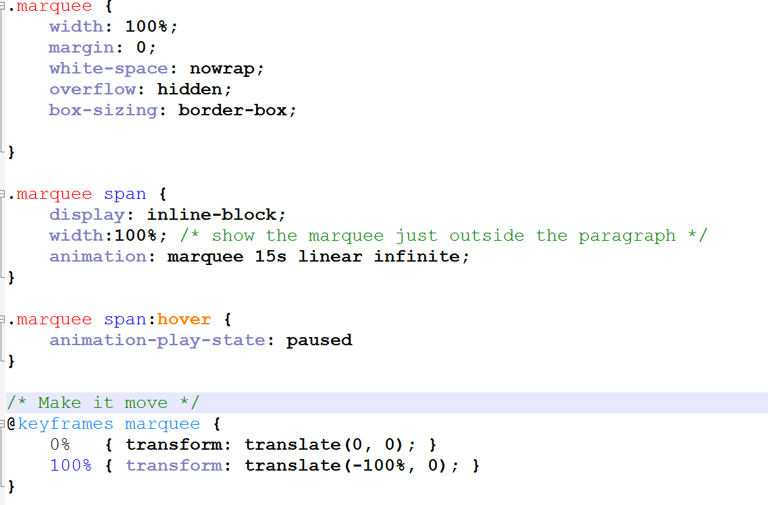
Code Snippet
Animation –code

Slide 10
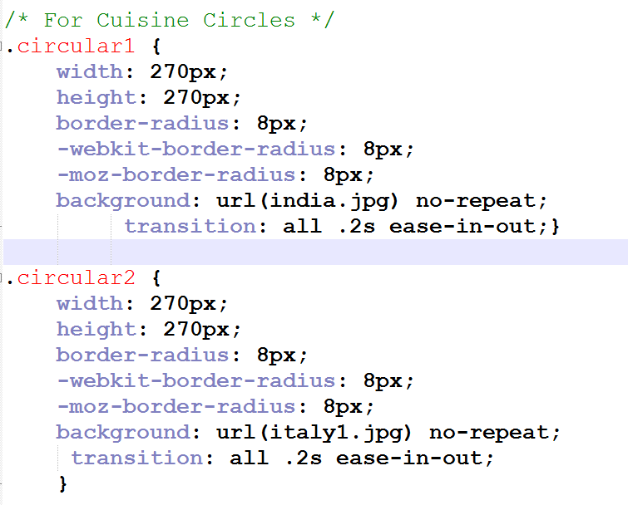
Zoom-out animation

